Slide 1
Software Testing (Advanced Part II)
Week 10

Slide 2
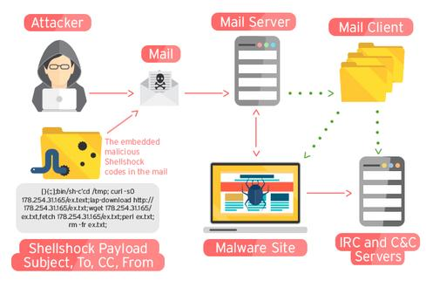


Security is often a software issue.
In Deloitte’s 2007 Global Security Survey, 87 percent of survey respondents cited poor software development quality as a top threat in the next 12 months.
Multiple CVE
CVE-2014-0160
Heartbleed
CVE-2014-6271
Shellshock
Notes:
Shellshock not only steal data, but may also gain control over the system and run arbitrary commands. Heartbleed returns the memory of the server with long length and short payload. The bound check can be enforced to prevent this bug. Stagefright causes buffer overflow of 3gpp metadata fields and is exposed to arbitrary code execution.

Slide 3
A Simple Vulnerability
while ((read = getch()) != ‘\0’)
{
name[id++] = read;
…..
}
getch() reads input from standard input terminal

Slide 4
A Simple Vulnerability
name[0]
name[1]
char name[100];
while ((read = getch()) != ‘\0’)
{
name[id++] = read;
…..
}
name[100]
Overwrite with
address holding
attacker code
Overwrite return
address with
name[>100]
Return address
getch() reads input from standard input terminal

Slide 5
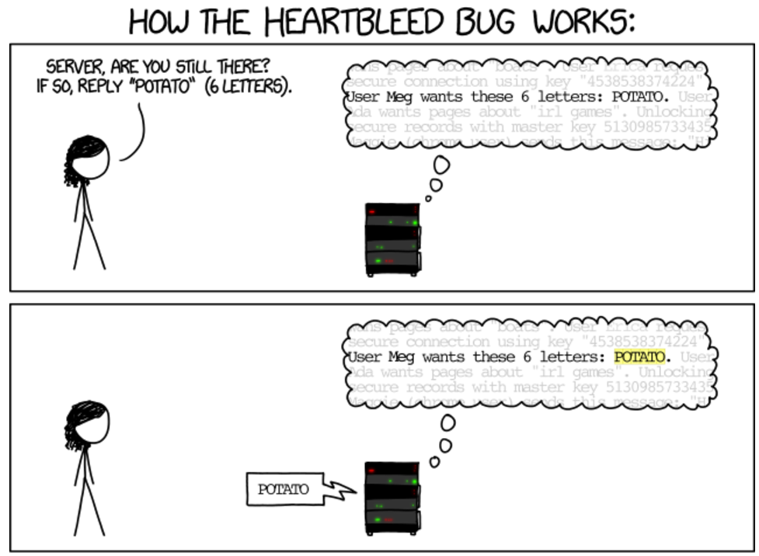
Overflow Example: Heartbleed
Heartbleed is a security bug in the OpenSSL cryptography library, which is a widely used implementation of the Transport Layer Security (TLS) protocol.
Details can be found at: https://cve.mitre.org/cgi-bin/cvename.cgi?name=CVE-2014-0160

Slide 6
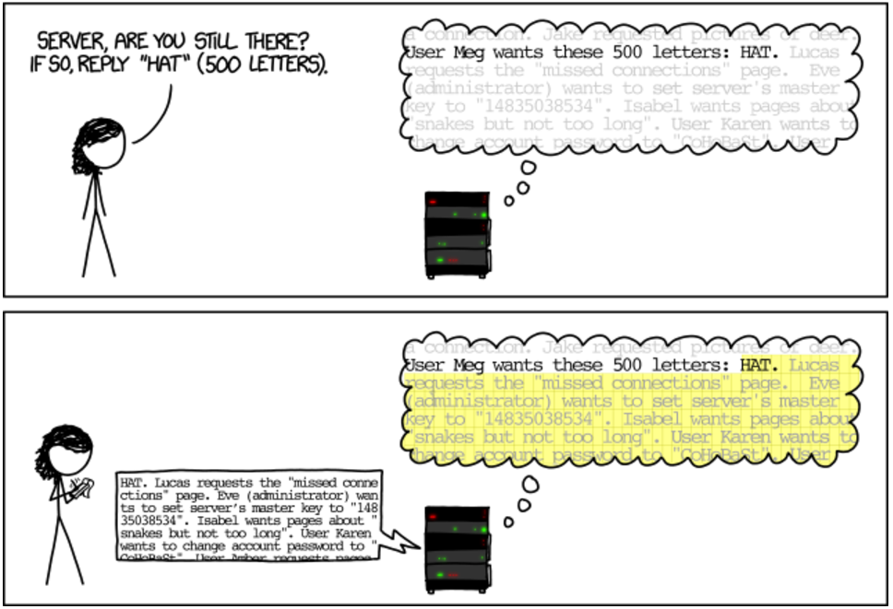
Example: Heartbleed
The Bug:
memcpy(bp, pl, payload);
where bp is a pointer, pl is where the data the client sent as a heartbeat is, and payload is a number that says how big pl is.
The Fix:
if (1 + 2 + payload + 16 > s->s3->rrec.length) return 0; /* silently discard per RFC 6520 sec. 4 */

Slide 7
How Does Testing Work?
Questions
How do we run tests?
How do we know whether the output is correct or not? (The oracle problem)
What inputs do we test and how do we generate them? (The test-generation problem)
When have we tested enough?
Sample Answers
jUnit
Selenium driver

Slide 8
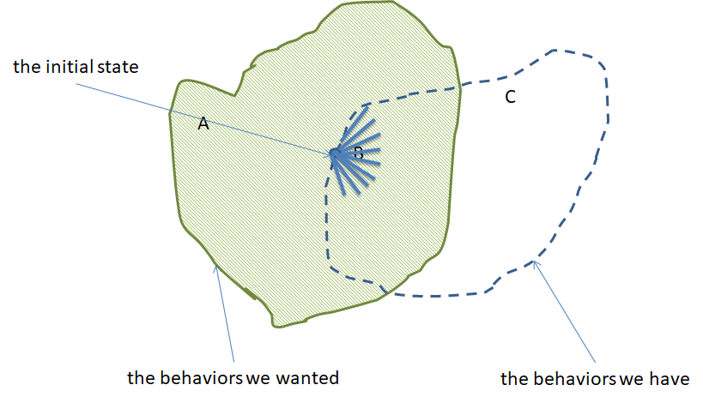
Testing: a Big Picture

Slide 9
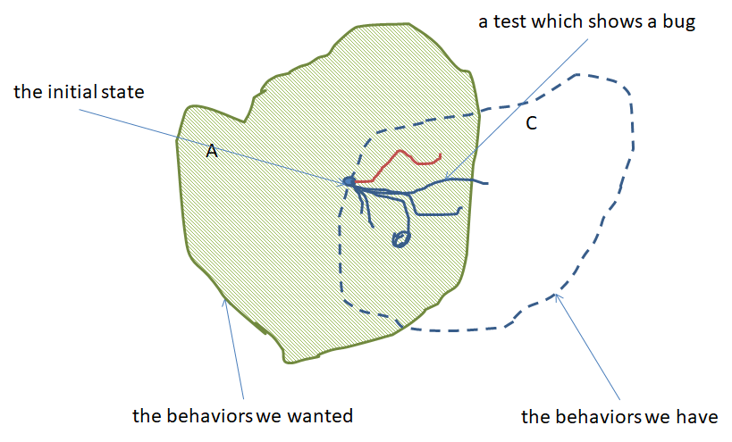
Testing: a Big Picture

Slide 10
Security Relevant Testing
Testing remains an effective way of checking functional correctness and security of systems.
Penetration testing
Fuzzing
Systematic testing
...

Slide 11
Fuzzing
Fuzzing or fuzz testing is an automated software testing technique that involves providing invalid, unexpected, or random data as inputs to a computer program.
Very long or completely blank strings
Maximum and minimum values for integers
Null characters, new line characters, semi-colons
Format string values (%n, %s, etc.)
Fuzzing aims to identify test inputs which reveal exploitable vulnerabilities.
Programmers often think in term of valid inputs!

Slide 12
Why Fuzzing
A study found that one-quarter to one-third of all utilities on every UNIX system that the evaluators could get their hands on would crash in the presence of random input.
A study that looked at 30 different Windows applications found that 21% of programs crashed and 24% hung when sent random mouse and keyboard input, and every single application crashed or hung when sent random Windows event messages.
A study found that OS X applications, including Acrobat Reader, Apple Mail, Firefox, iChat, iTunes, MS Office, Opera, and Xcode, were even worse than the Windows ones.

Slide 13
Fuzzing: Pros and Cons
Pros
Can provide results with little effort
Can reveal bugs that were missed in a manual audit
Provides an overall picture of the robustness of the target software
Cons
Will not find all bugs
The crashing test cases that are produced may be difficult to analyse, as the act of fuzzing does not give you much knowledge of how the software operates internally
Programs with complex inputs can require much more work to produce a smart enough fuzzer to get sufficient code coverage

Slide 14
Fuzzing Phases
Identify target
Identify inputs
Generate fuzzed data
Execute fuzzed data
Monitor for exceptions/errors/crashes
Determine exploitability
The central question: how to smartly generate fuzzed data?

Slide 15

Security Testing
Picture:
https://en.wikipedia.org
Let’s put a monkey

Slide 16
Fuzzing
Pass
Test
Oracle
Input
Program
Fail
Let’s put a monkey

Slide 17

Fuzzing
Pass
Test
Oracle
Input
Program
Fail
%^web3r@#$3423
Random Testing at the System Level

Slide 18
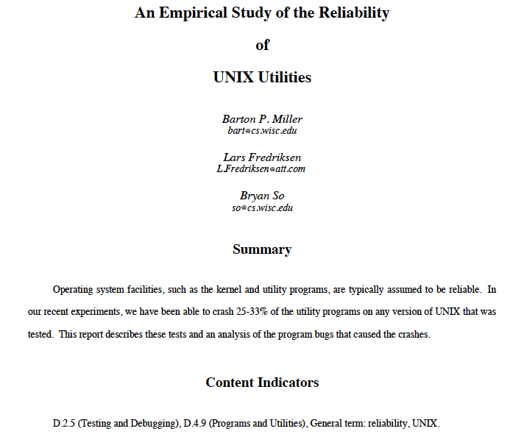

Slide 19
Fuzzing
Fuzzer
UNIX Utilities
%^web3r@#$3423
25%-33%
Random Testing at the System Level

Slide 20
Fuzzer Output
`,a=~F]8b'<Dks}jG[BCO:U65~3+hAO[(qs=z!X?|G_>Ia3<yNm\hO6#R;C-Fkmo\U$5l2qpm"$#QM7',bI{x^B$MXW`JxdguN@Cz2m=]*-T2_IfWJo(&3+QPz j?w+FX:iif ey$~6WykYgC^(GZ[d*Qd6M+O>Gh*TLThD\Sxk`;8J2g'1bPH2bb1O`^LGRZ?MNt>2trkvJ Gm`W|(+4@/\W/ByT7HAsZ#_4}abq)50ghBfs
simple-fuzzer.c

Slide 21
Reasons for Bombing
Arrays and Pointers
Not checking return code of a function
…

Slide 22
Safe Coding Practices
Check all array bounds
Apply bounds on program inputs
Check all return values of a function
Do not trust third-party inputs
All supported by modern programming languages

Slide 23

Fuzzer Output
Z(cG*mOGaQ%%SWbFUXVGZin.,Kg5x)a0fM{,3+{Pd=X#s-'^*\m<rG%~Z)"ZWqeJJox'w|dV7$Xb$K)"xl@5=8LW`VFZAqsk,Aaxm0;6bh6H]S+pj=\#M3CwSy\$Ko?`t.tR!@A|gQy[^V$\2!d1'++kx_!7)WTmWE_gHxLKS*cT$\:[AZ01Uv;/LB,Z?1cb]\|*^EL\X%|l#3VE06A=N0z'2X*/hLL?<iBt<Q'\oOFDUy]7)-6e2e>PyNkU7'\!HKiD}H/Z}R8l5?R=U@|qn>930P])<bP33ly$i/(74c$Ntq`r!|`ioyW!1!&:c`JZsAD3CkZ!J?@aF!/7;aNc435.tVL)vSg5;drQBV+T_<NFU!!Ab'U{zvV(g:\N+.X&5i:}?85r] t4#Te?;T~]YVTehejfqY=\}rD*Or~loWfn$4dxQ8u0/JKlFQd5:"X|?P#Z"&VD#l&yswfrNZo(\igNKFf{S&2`l.7O/$trZzrbt`eh/_{Zlz]Vs&=WFMSK,\9huTKuZX"5OB=Fl:O0#&|db/uY&WKm^HB7}xt"mK(]s:/6j)uqIPzh#$h=k4F6r6@?^;2hV]'WrKIAb`WY"CG+fM.npbOzoZ9JAJ@PS?-SxnyVvb({2Ja]b?.1*Y!S`vTRnms$Er9e9'U"+_0<gq>WS*J:I1XJzt\.Dh%C:ePg`7oc[E+db9-?TI.&49O9Z#WNvPmFhUgJmL8v+WSN@o/[;f(RIPkoBabRzDNV$77MBw4\hpkUI)4+K QK3(4ot!xuwosP)
Most Programs reject invalid inputs

Slide 24
Challenge
Z(cG*mOGaQ%%SWbFUXVGZin.,Kg5x)a0fM{,3+{Pd=X#s-'^*\m<rG%~Z)"ZWqeJJox'w|dV7$Xb$K)"xl@5=8LW`VFZAqsk,Aaxm0;6bh6H]S+pj=\#M3CwSy\$Ko?`t.tR!@A|gQy[^V$\2!d1'++kx_!7)WTmWE_gHxLKS*cT$\:[AZ01Uv;/LB,Z?1cb]\|*^EL\X%|l#3VE06A=N0z'2X*/hLL?<iBt<Q'\oOFDUy]7)-6e2e>PyNkU7'\!HKiD}H/Z}R8l5?R=U@|qn>930P])<bP33ly$i/(74c$Ntq`r!|`ioyW!1!&:c`JZsAD3CkZ!J?@aF!/7;aNc435.tVL)vSg5;drQBV+T_<NFU!!Ab'U{zvV(g:\N+.X&5i:}?85r] t4#Te?;T~]YVTehejfqY=\}rD*Or~loWfn$4dxQ8u0/JKlFQd5:"X|?P#Z"&VD#l&yswfrNZo(\igNKFf{S&2`l.7O/$trZzrbt`eh/_{Zlz]Vs&=WFMSK,\9huTKuZX"5OB=Fl:O0#&|db/uY&WKm^HB7}xt"mK(]s:/6j)uqIPzh#$h=k4F6r6@?^;2hV]'WrKIAb`WY"CG+fM.npbOzoZ9JAJ@PS?-SxnyVvb({2Ja]b?.1*Y!S`vTRnms$Er9e9'U"+_0<gq>WS*J:I1XJzt\.Dh%C:ePg`7oc[E+db9-?TI.&49O9Z#WNvPmFhUgJmL8v+WSN@o/[;f(RIPkoBabRzDNV$77MBw4\hpkUI)4+K QK3(4ot!xuwosP)
How do we get a Fuzzer to generate valid inputs?

Slide 25

Idea
ISTDisApillarInSUTDbutItsNameiSGoingToChange
Leverage existing VALID inputs

Slide 26
Mutation
ISTDisApillarInSUTDbutItsNameiSGoingToChange
Trim at a random position
ISTDisApillarInSUTDbutIts
mutation-fuzzer.c

Slide 27
Mutation
ISTDisApillarInSUTDbutItsNameiSGoingToChange
Select a position randomly
ISTDisApillarInSUTDbutItsNameiSGoingToChange
Flip a random bit of the selected position
ISTDisApillarYnSUTDbutItsNameiSGoingToChange
mutation-fuzzer.c

Slide 28
Mutation Operators
Flipping a bit
Trimming
Swapping characters
Inserting characters
Mutation operators are chosen at random in every iteration

Slide 29
Cohort Exercise 1
Given an input string, implement a mutation operator that choose a random position in the string and swap the adjacent characters. Meaning if SUTD is an input string and 2 is chosen as the random position, the output should be SUDT. Careful about the string length bound check.
mutation-fuzzing-swap.*

Slide 30
Fuzzer Output
Z(cG*mOGaQ%%SWbFUXVGZin.,Kg5x)a0fM{,3+{Pd=X#s-'^*\m<rG%~Z)"ZWqeJJox'w|dV7$Xb$K)"xl@5=8LW`VFZAqsk,Aaxm0;6bh6H]S+pj=\#M3CwSy\$Ko?`t.tR!@A|gQy[^V$\2!d1'++kx_!7)WTmWE_gHxLKS*cT$\:[AZ01Uv;/LB,Z?1cb]\|*^EL\X%|l#3VE06A=N0z'2X*/hLL?<iBt<Q'\oOFDUy]7)-6e2e>PyNkU7'\!HKiD}H/Z}R8l5?R=U@|qn>930P])<bP33ly$i/(74c$Ntq`r!|`ioyW!1!&:c`JZsAD3CkZ!J?@aF!/7;aNc435.tVL)vSg5;drQBV+T_<NFU!!Ab'U{zvV(g:\N+.X&5i:}?85r] t4#Te?;T~]YVTehejfqY=\}rD*Or~loWfn$4dxQ8u0/JKlFQd5:"X|?P#Z"&VD#l&yswfrNZo(\igNKFf{S&2`l.7O/$trZzrbt`eh/_{Zlz]Vs&=WFMSK,\9huTKuZX"5OB=Fl:O0#&|db/uY&WKm^HB7}xt"mK(]s:/6j)uqIPzh#$h=k4F6r6@?^;2hV]'WrKIAb`WY"CG+fM.npbOzoZ9JAJ@PS?-SxnyVvb({2Ja]b?.1*Y!S`vTRnms$Er9e9'U"+_0<gq>WS*J:I1XJzt\.Dh%C:ePg`7oc[E+db9-?TI.&49O9Z#WNvPmFhUgJmL8v+WSN@o/[;f(RIPkoBabRzDNV$77MBw4\hpkUI)4+K QK3(4ot!xuwosP)
Parser
The parser rejects invalid input

Slide 31
Idea
Parser
Get a format of the valid inputs

Slide 32
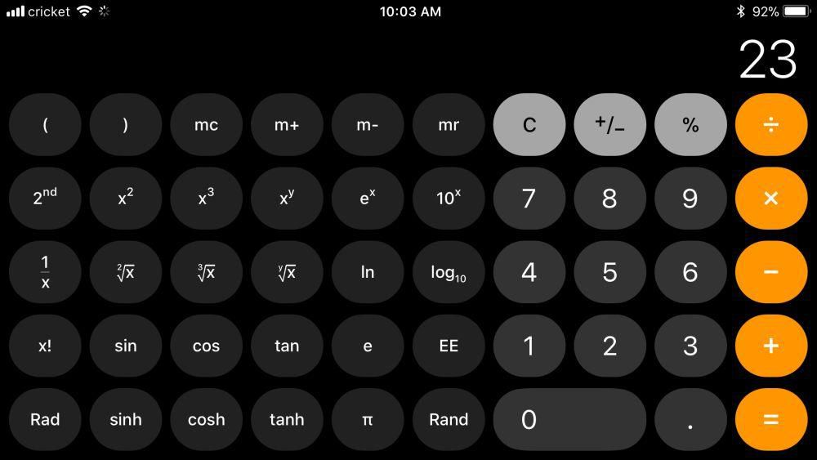
Idea
Calculator
Parser
Calculator supports arithmetic expressions

Slide 33
Idea
Calculator
Parser
1+3, 3+1/2, 4*(5+1)-1 are valid inputs

Slide 34
Idea
Calculator
Parser
1/*1, +-21/12, 2---- are invalid inputs

Slide 35
Idea
S := Expr
Expr := Expr + Term | Expr – Term | Term
Term := Term * Factor | Term / Factor | Factor
Factor := -Integer | (Expr) | Integer | Integer.Integer
Integer := Digit | IntegerDigit
Digit := 0 | 1 | 2 | 3 | 4 | 5 | 6 | 7 | 8 | 9
Rules
Capture valid inputs by a grammar

Slide 36
Derivation of inputs from grammar
S
Expr
Expr
+
Term
Term
Generates 5+2*3
Term
*
Factor
Factor
Factor
Integer
Integer
Integer
3
5
2
Capture valid inputs by a grammar

Slide 37
Cohort Exercise 2
Draw the derivation tree for input (23 * 56) / (1.2 + 2)

Slide 38
Cohort Exercise 3
Use any programming language to implement a fuzzer that will randomly generate inputs to the calculator conforming to the grammar. For now, you can hardcode the expression grammar.
Hint: Start with the initial rule S := Expr and at each point, apply a rule at random. For example, randomly choose any of the rule Expr := Term, Expr := Expr + Term or Expr – Term in the next step. Continue until a valid expression for the calculator is obtained. Make sure you do not expand the rules forever to avoid infinite loop.
calculator-grammar-fuzzing.*

Slide 39
Feedback-based Fuzzing
Example
AFL (American Fuzz Lop) is a well-known fuzzer which is responsible for finding significant software bugs in dozens of major free software projects, including PHP, OpenSSL, Firefox, etc.
http://lcamtuf.coredump.cx/afl/
Generate Test Cases
Execute Test Cases
Collect Feedback
The idea is to tune the test case generation problem into an optimization problem.

Slide 40
Collect Feedback
One way to measure the effectiveness of a set of test cases is code coverage criteria.
We can instruct the program to collect coverage measurement. For instance, for branch coverage, we instructment each branch so as to know whether it is covered by a test case.
Example
int func (int[] B, int N) {
int i = 0;
int s = 0;
if ( i != N) {
//print: “branch coverage”;
i = i+1;
s = s +B[i];
}
return s;
}

Slide 41
Code Instrumentation
Useful for
Code coverage measurement
Memory and performance profiling and runtime tracing
Runtime verification
Considerations
Runtime overhead
There are existing tools for systematic code instrumentation (e.g., Soot).

Slide 42
Collect Feedback: Crash Detection
If you cannot accurately determine when a program has crashed, you will not be able to identify a test case as triggering a bug.
Attach a debugger: most accurate, significantly overhead
Runtime-monitoring through code instrumentation: e.g. AddressSanitizer
Timeout: to know whether a deadlock or infinite loop has been triggered.
Example
void func (char *str) {
char buff[12];
//add: if (strlen(str) > 12)
// printf(“overflow”)
strcpy(buff, str);
}

Slide 43
Generate New Test Cases
The fuzzer gradually evolves a set of test cases that improves code coverage.
Example:
Genetic Algorithms
Simulated Annealing
History
Genetic Algorithms were invented to mimic some of the processes observed in natural evolution.
The idea with GA is to use this power of evolution to solve optimization problems.
The father of the original Genetic Algorithm was John Holland who invented it in the early 1970's.

Slide 44
Genetic Algorithm
Overall Idea
GAs simulate the survival of the fittest among individuals over consecutive generation for solving a problem.
Each generation consists of a population of test inputs that are analogous to the chromosome that we see in our DNA.
Each individual represents a point in a search space and a possible solution. The individuals in the population are then made to go through a process of evolution.
Algorithm
randomly initialize population(t)
determine fitness of population(t)
Repeat
select parents from population(t);
perform crossover for population(t+1)
perform mutation of population(t+1)
determine fitness of population(t+1)
until best individual is good enough
Example: GA directory

Slide 45
Genetic Algorithm
Selection Operator
key idea: give preference to better individuals, allowing them to pass on their genes to the next generation.
The goodness of each individual depends on its fitness.
Example:
static int getFitness(Individual individual) {
int fitness = 0;
for (int i = 0; i < individual.size(); i++) {
fitness-=Math.abs(individual.getGene(i)-solution[i]);
}
return fitness;
}
The fitness is defined based on the accumulated difference of each character.

Slide 46
Genetic Algorithm
Crossover Operator
Two individuals are chosen from the population through the selection operator.
The values of the two individuals are exchanged.
The new offspring created from this mating are put into the next generation of the population.
Example:
private static Individual crossover(Individual indiv1, Individual indiv2) {
Individual newSol = new Individual();
for (int i = 0; i < indiv1.size(); i++) {
if (Math.random() <= uniformRate) {
newSol.setGene(i, indiv1.getGene(i));
} else {
newSol.setGene(i, indiv2.getGene(i));
}
}
return newSol;
}
The offspring is a random combination of the parents.

Slide 47
Genetic Algorithm
Mutation Operator
With some probability, a portion of the new individuals will have some of their genes mutated.
Its purpose is to maintain diversity within the population and inhibit premature convergence.
Mutation alone induces a random walk through the search space.
Example:
private static void mutate(Individual indiv) {
for (int i = 0; i < indiv.size(); i++) {
if (Math.random() <= mutationRate) {
Random r = new Random();
char c = (char)(r.nextInt(95) + 32);
indiv.setGene(i, c);
}
}
}
Pick a random gene and mutate it randomly.

Slide 48
Cohort Exercise 5
1. Study the implementation of the Genetic Algorithm provided.
2. Modify the provided genetic algorithm so that it generates any palindrome string with 64 characters.
How do you define the fitness function?
How do you define the selection/crossover/mutation operator?

Slide 49
Cohort Exercise 6
Apply EvoSuite to generate test cases class.
Download
https://github.com/EvoSuite/evosuite/releases/download/v1.0.6/evosuite-1.0.6.jar
Add it to your project building path
Run Test.java

Slide 50
Cohort Exercise 7
Write two example classes both of which have the same number of conditional branches as the Example.java, however, one of them is easier to test and the other is harder to test as compared to Example.java.
Compare the performance of Evosuite for both the examples (the one in the previous example and the ones you come up with in this exercise). Concretely, compare the conditional branch coverage and the average coverage over all coverage criterions. Also compare the time taken for Evosuite for all cases.
Argue why your examples takes less/more time (they should!!!!) to test as compared to Example.java.

Slide 51
White-Box Fuzzing
Fuzzing is a form of random testing, which has its limitations.
Fuzzing is likely to find the bug in the following code.
public static void example(int x, int y) {
int[] array = new int[10];
array[x] = y; //x must be [0..9]
}
Fuzzing is unlikely to find the bug in the following code.
public static void example(int x, int y) {
int[] array = new int[10];
if (y == 42342531) {
array[x] = y; //x must be [0..9]
}
}

Slide 52
We Do Logical Reasoning
public static void example(int x, int y) {
int[] array = new int[10];
if (x > 0) {
assert(x>=0);
Array[x] = 5;
}
}
Will assertion failure occur?

Slide 53
We Do Logical Reasoning
public static void func (int x, int y) {
0. int[] array = new array [10];
1. if (x>y) {
2. x = x + y;
3. y = x – y;
4. x = x – y;
5. if (x-y>0) {
6. array[10]=0;
7. }
8. }
Will error occur?

Slide 54
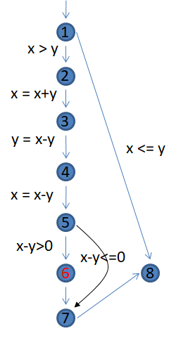
We Do Logical Reasoning
public static void func (int x, int y) {
0. int[] array = new array [10];
1. if (x>y) {
2. x = x + y;
3. y = x – y;
4. x = x – y;
5. if (x-y>0) {
6. array[10]=0;
7. }
8. }

Slide 55
We Do Logical Reasoning
Error occurs if and only if the following path condition is satisfiable:
x1 > y1 &&
x2=x1 && y2 = y1 &&
x3=x2+y2 && y3 = y2 &&
x4=x3 && y4=x3-y3 &&
x5=x4-y4 && y5=y4 &&
x5-y5>0
xi = value of “x” immediately before node “i”
yi = value of “y” immediately before node “i”

Slide 56
Constraint Solving
How do we efficiently know whether the following constraint is satisfiable or not?
x1 > y1 &&
x2=x1 && y2 = y1 &&
x3=x2+y2 && y3 = y2 &&
x4=x3 && y4=x3-y3 &&
x5=x4-y4 && y5=y4 &&
x5-y5>0
We use automatic constraint solvers.

Slide 57
Exercise
Go to https://rise4fun.com/Z3
Load logical_reasoning.z3 in the box and see the result
Now change the last assertion to enforce x5 <= y5
Add (get-model) before the (exit)
Discuss the results

Slide 58
Symbolic Execution
Rather than executing a program with concrete input value, execute it with symbolic variables representing the inputs.
Proposed in 1976: “A System to Generate Test Data and Symbolically Execute Programs”, IEEE Transactions on Software Engineering by L. A. Clarke.
Popularized only in recent years due to advancement in constraint solving techniques.
Used for white-box fuzzing, e.g. Microsoft SAGE.

Slide 59
Symbolic Execution Engines
KLEE based on LLVM
Pex from Microsoft for .NET
JPF (Java Path Finder) and JDart for Java programs
Jalangi2 for JavaScript
Oyene for smart contracts

Slide 60
Symbolic Execution Tree
What is Symbolic Execution
Executing a program with un-instantiated values for certain variables
E.g. input variables
Since some values are un-instantiated the execution is NOT a sequential trace any more
The symbolic execution forms a tree where each path from the root of the tree to its leaf corresponds to a unique execution path
Symbolic Execution Tree

Slide 61
Symbolic Execution Tree
Purpose of Symbolic Execution
Provided enough time, it can explore all execution paths of a program
Often infeasible in practice.
test_sym.c

Slide 62
Exercise
Download and install Virtualbox and Load the virtual machine
User name: side_channel
Password: cache_channel
Run KLEE
Open a terminal and go to the folder 50.003.
Run llvm-gcc –emit-llvm –o test_simple.bc –c test_simple.c
Run klee –write-smt2s test_simple.bc
Investigate klee-last/test000*.smt2

Slide 63
Symbolic Execution: Limitation
Path Explosion
int x = input();
while (x > 0) {
x++;
assert(x < Integer.MAX_VALUE);
}
How do we handle loops?
check all paths which reach the assertion in one iteration.
… in two iterations.
… in three iterations.
When does it end?
(Typical solution: we check up to certain number of iterations, or we find out somehow all possible x values).

Slide 64
Symbolic Execution: Limitation
Incompleteness
public static void func (int x, int y, int z) {
if (x*x*x*x + y*y*y < z*z) {
assert(false);
}
}
SMT solver is no magic
Existing SMT solvers supports theories on linear integer arithmetic, bit vectors, string, etc.
Existing SMT solvers are not particularly scalable or efficient for certain theories.

Slide 65
Homework
Implement a generalized fuzzer that will take a file, read each line of the file, randomly choose a mutation operator (swap, bit flip or trim) and produce a different file with the modified lines. This means for each input file, the fuzzer will produce one output file, where each line is modified with a random mutation operator. Choose any programming language. Make your program modular so that more mutation operators can be added easily.
mutation-fuzzing.*

